Slide 1

Sorting algorithm
HIGH PERFORMANCE COMPUTING
10/22/2025

Slide 2
Agenda
Introduction - The Importance of Sorting
Overview of Sorting Algorithms
Comparison-Based Sorting Algorithms
Non-Comparison-Based Sorting Algorithms
Parallel Sorting Techniques
Optimizations for High-Performance Computing
Choosing the Right Algorithm
Performance Evaluation and Benchmarking
Case Studies
Challenges and Future Directions
Practical Demonstration
Conclusion
Q&A
References

Slide 3
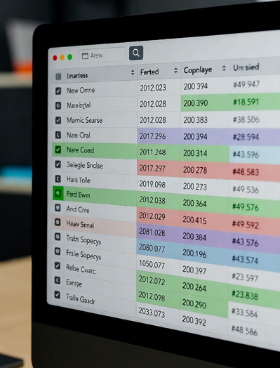
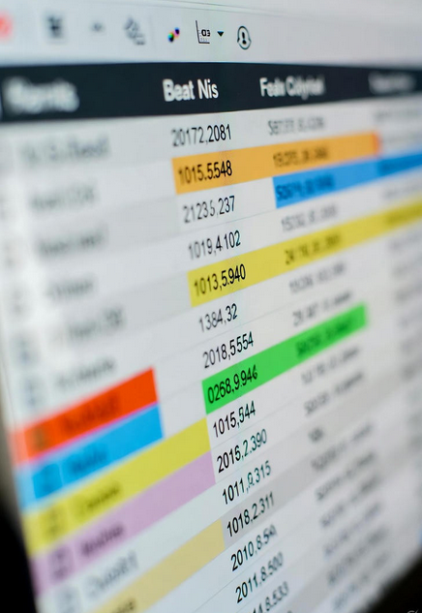
introduction
Sorting is a foundational operation in computer science, enabling efficient data organization.
Critical for applications like databases, search engines, machine learning, and scientific simulations.
In high-performance computing (HPC), sorting efficiency directly impacts processing massive datasets.
Inefficient sorting can bottleneck performance in data-intensive applications.
Example: Google’s search indexing relies on sorting to rank results; financial trading systems sort transactions in real-time.

Slide 4

Overview of Sorting Algorithms
A Spectrum of Sorting Algorithms
Algorithm | Time Complexity (Avg) | Space Complexity | Stable? | Parallelizable?
Bubble Sort | O(n²) | O(1) | Yes | No
Insertion Sort | O(n²) | O(1) | Yes | Limited
Merge Sort | O(n log n) | O(n) | Yes | Yes
Quicksort | O(n log n) | O(log n) | No | Yes
Heapsort | O(n log n) | O(1) | No | Limited
Counting Sort | O(n + k) | O(k) | Yes | Yes
Radix Sort | O(nk) | O(n + k) | Yes | Yes
Bucket Sort | O(n) | O(n) | Yes | Yes
Notes:
Comparison-Based: Bubble sort, insertion sort, merge sort, quicksort, heapsort.
Non-Comparison-Based: Counting sort, radix sort, bucket sort.
Key Considerations: Time complexity, space complexity, stability, and parallelizability.

Slide 5

Comparison-Based Sorting Algorithms
Bubble Sort: Simple, intuitive, but inefficient for large datasets (O(n²)).
Insertion Sort: Ideal for small or nearly sorted datasets (O(n) best case).
Merge Sort: Stable, predictable O(n log n), excels in parallel and distributed systems.
Quicksort: Fast average case (O(n log n)), but O(n²) worst case; optimized with random pivots.
Heapsort: Consistent O(n log n), in-place but not stable; higher constant factors.

Slide 6
Non-Comparison-Based Sorting Algorithms
Counting Sort: Linear time (O(n + k)) for integers in a fixed range; non-comparative.
Radix Sort: Processes digits iteratively (O(nk)); ideal for fixed-length keys (e.g., IP addresses).
Bucket Sort: Distributes data into buckets, sorts each (O(n) average); suits uniform distributions.
Use Case: Radix sort is used in bioinformatics for sorting DNA sequences.

Slide 7
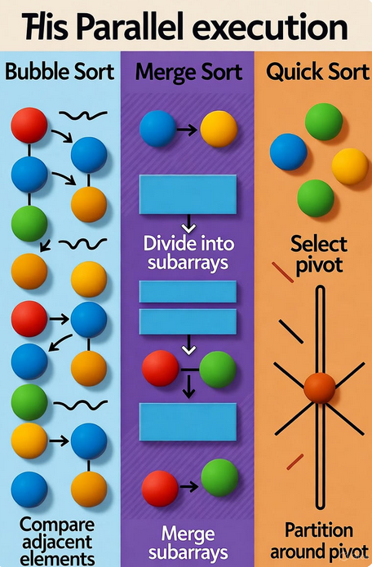
Parallel Sorting Techniques
Why Parallelism? Leverages multi-core CPUs, GPUs, and clusters to reduce sorting time.
Parallel Merge Sort: Splits data across cores, sorts chunks, and merges in parallel.
Parallel Quicksort: Partitions data in parallel, recursively sorts subarrays concurrently.
Parallel Radix Sort: Distributes digits across processors, combines results efficiently.
Example: Apache Spark uses parallel sorting for big data analytics.
Notes:
The OK Code Implementation:
The code initializes an array with increasing integers.
It uses OpenMP to parallelize the summation of the array elements, resulting in improved performance on multi-core systems.

Slide 8
Optimizations for High-Performance Computing
Cache-Aware Sorting: Aligns data access to cache lines (e.g., tiled merge sort).
Vectorization (SIMD): Uses SIMD instructions (e.g., Intel AVX, ARM NEON) for parallel processing.
GPU-Accelerated Sorting: Bitonic sort and radix sort optimized for GPUs (e.g., CUDA, OpenCL).
Hybrid Approaches: Combines quicksort (large partitions) with insertion sort (small partitions).
Example: NVIDIA’s Thrust library accelerates sorting on GPUs.

Slide 9
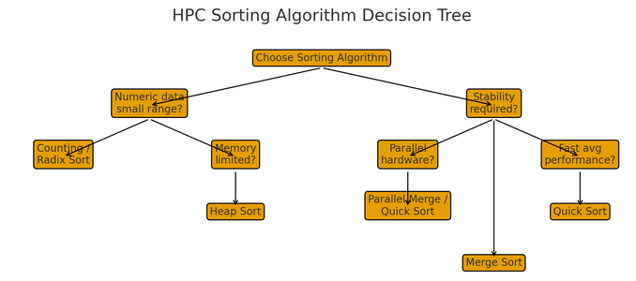
Choosing the Right Algorithm
Key Factors:
Data Size: Small datasets favor insertion sort; large datasets need O(n log n) algorithms.
Data Distribution: Uniform data suits bucket sort; known ranges favor counting sort.
Hardware: Multi-core CPUs benefit from parallel merge sort; GPUs favor bitonic sort.
Constraints: Memory, stability, and real-time requirements.
Guidelines:
Small datasets (<100 elements): Insertion sort.
General-purpose: Quicksort or merge sort.
Specialized data: Counting or radix sort.
HPC: Parallel or GPU-accelerated algorithms.

Slide 10
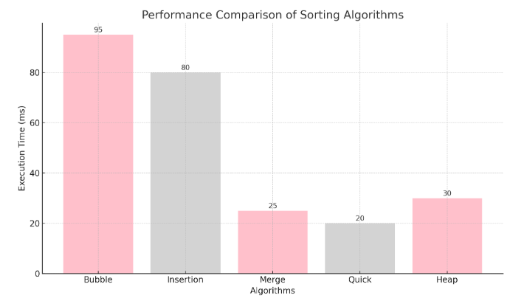
Performance Evaluation and Benchmarking
Why Benchmark? Validates theoretical performance on real hardware.
Metrics:
Execution time (wall-clock time).
Throughput (elements sorted per second).
Memory usage and cache efficiency.
Tools: Linux time command, HPC profiling tools (example: Intel VTune, NVIDIA Nsight).
Test Cases: Vary dataset sizes: 10K, 1M, 100M elements, and distributions of random, nearly sorted, reverse sorted.

Slide 11

Case Studies
Database Systems: Efficient indexing in SQL databases (such as PostgreSQL’s B-tree sorting).
Scientific Simulations: Sorting particle positions in N-body simulations for astrophysics.
Data Analysis: Sorting massive datasets in Apache Hadoop or Spark for analytics.
Machine Learning: Sorting feature vectors for k-nearest neighbors or decision tree training.
Real-World Example: Sorting in the Large Hadron Collider (LHC) Data Processing
Context: The LHC at CERN generates petabytes of particle collision data for event reconstruction.
Sorting Application: Parallel radix sort organizes particle tracks by attributes (e.g., momentum, energy) across distributed clusters.
Impact: Enables real-time filtering, reducing analysis time by ~40%, critical for discoveries like the Higgs boson.
HPC Relevance: Uses parallel sorting on multi-core CPUs and GPUs to handle high-velocity data.

Slide 12
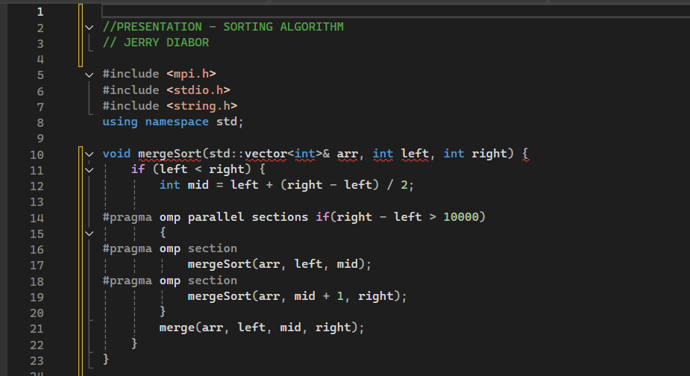
Practical Demonstration
Showcasing a parallel merge sort implementation using OpenMP.
Key optimizations: Cache-aware data splitting, parallel recursive calls.
Compare performance with sequential merge sort.
Notes:
Hybrid Use: Combine for multi-level parallelism (e.g., my supply chain sims).
Visual: Table with color-coded cells.
Importance: Choice depends on my workload - OpenMP for local, MPI for global.

Slide 13
Challenges and Future Directions
Challenges:
Sorting datasets larger than main memory (external sorting).
Optimizing for heterogeneous architectures (CPU + GPU + TPU).
Energy-efficient sorting for sustainable HPC.
Future Directions:
Algorithms tailored for quantum or neuromorphic computing.
Machine learning-driven algorithm selection (e.g., auto-tuning).
Advanced memory hierarchies (e.g., Intel Optane persistent memory).
Emerging Trend: Sorting networks for quantum computing research.
Notes:
Hybrid Use: Combine for multi-level parallelism (e.g., my supply chain sims).
Visual: Table with color-coded cells.
Importance: Choice depends on my workload - OpenMP for local, MPI for global.

Slide 14
Conclusion and future work
Sorting is a cornerstone of HPC, impacting performance across domains.
Algorithm choice depends on data size, distribution, hardware, and constraints.
Parallelism, cache awareness, and GPU acceleration unlock significant performance gains.
Ongoing research pushes sorting efficiency boundaries, from quantum computing to AI-driven optimization.
Call to Action: Benchmark sorting algorithms on your systems or contribute to open-source HPC projects.
Quote: “Sorting is not just about order—it’s about unlocking the potential of data at scale.”

Slide 15
References
Cormen, T. H., et al. Introduction to Algorithms (MIT Press).
Knuth, D. E. The Art of Computer Programming, Vol. 3: Sorting and Searching.
Cole, R. “Parallel Merge Sort” (SIAM Journal on Computing, 1988).
NVIDIA CUDA Documentation: https://docs.nvidia.com/cuda/
OpenMP Specifications: https://www.openmp.org/
CERN Open Data Portal: https://opendata.cern.ch/
Open-Source Libraries: Boost.Sort, NVIDIA Thrust.

Slide 16
THANK YOU
Jerry Diabor​
202-230-0215​
diaborj1105@students.bowiesdtate.edu​

